Slide 1
Accident casualties Analysis Report
By: Samuel A. Opoku

Slide 2
Project Overview
This analysis aims to provide insight into the accident incidence in England by analyzing various aspects to identify trends make data-driven decisions and get a deep understanding of the causes of accidents in the various districts.

Slide 3
Data Source
The primary data used for the analysis is an accident data sourced from HERE

Slide 4
Tools
For this analysis, MySQL, Microsoft Excel and Power BI were used for cleaning, mining, analyzing, and visualizing using Power Query, Power View

Slide 5
Data Preparation
The data was prepared for analysis and it was ensured the data was clean by;
loading and inspecting the data
deleting all duplicated entries
formatting the data into the appropriate types, (texts are in proper format, all unnecessary spaces and special characters were removed and numbers were in number format)
Creating new columns
replacing missing values.

Slide 6
Exploratory Data Analysis (EDA)
The data was further explored to find the following KPIs;
What was the total number of casualties?
How many casualties were fatal?
How many casualties were serious?
How many casualties were slight?
What was the trend in casualties in 2021 and 2023?

Slide 7
Exploratory Data Analysis (EDA)
The data was further explored to find trends in;
Casualties by light
Casualties by surface area
Casualties by area
Casualties by road type
Casualties by light
Casualties by vehicle type

Slide 8
Data Analysis
To find the number of casualties by road surfaces, all other types of road surface were grouped into wet, snow and dry
To find the number of casualties by light conditions, the conditions were grouped into Daylight and dark
New Measures were computed to calculate the severity of casualties
Charts were also used for further analysis

Slide 9
Results & Findings
After the analysis, it was found that,
The total number of casualties was 409,000.
There were 7009 fatal casualties.
There were about 58,000 serious casualties.
There were about 343,000 casualties with slight injuries.
110,000 accident casualties occurred during the dark while 298,000 occurred during daylight.
250,000 casualties occurred in the urban centers while 159,000 occurred in the rural areas
328,000 casualties occurred by cars which is the most while 994 was by farm vehicles which is the least.

Slide 10
Results & Findings con’t
After the analysis, it was found that,
272,000 casualties occurred on dry surface, 113,000 on a wet surface and 22,000 on snowy surface.
304,000 casualties occurred on a single carriage road, 66,000 on a dual carriage roads 26,000 on roundabout with the least being 5,000 on a slip road

Slide 11
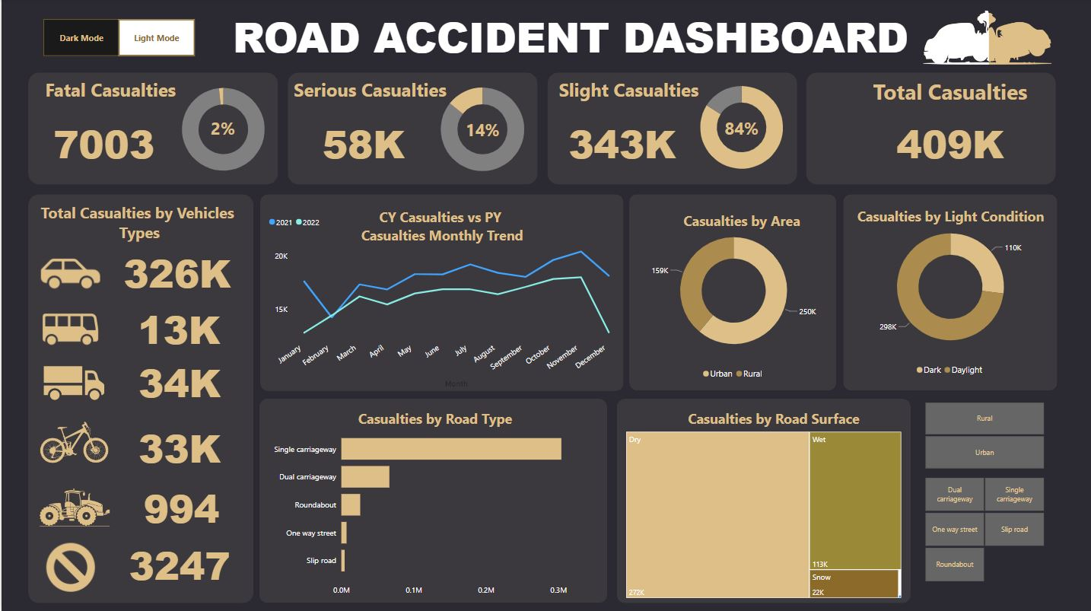

Slide 12
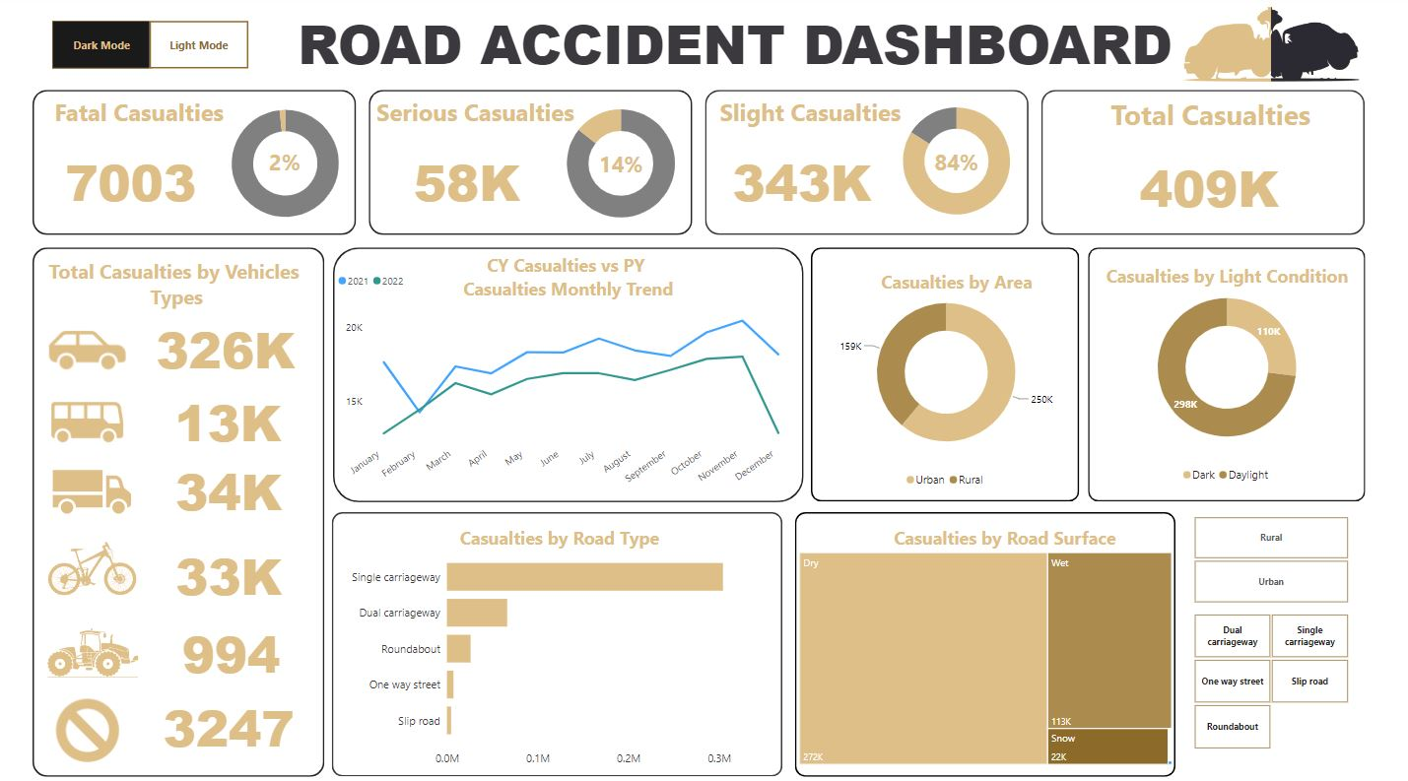

Slide 13
Recommendations
Since most accidents occur during daylight, policymakers must intensify traffic regulations to regulate the number of accidents.
Since most casualties were by cars, cars must be properly checked, and divers must be educated on road safety measures.
Policies on traffic regulations in the urban centers must be intensified to reduce the number of casualties in the urban areas.
More speed ramps must be constructed on dry road surfaces to slow down drives.

